Slide 1
Introduction to using R for Spatial Analysis
Wed 29th April, 9:30am – 4pm
Dr Nick Bearman
@nickbearmanuk
Department of Geography and Planning

Slide 2
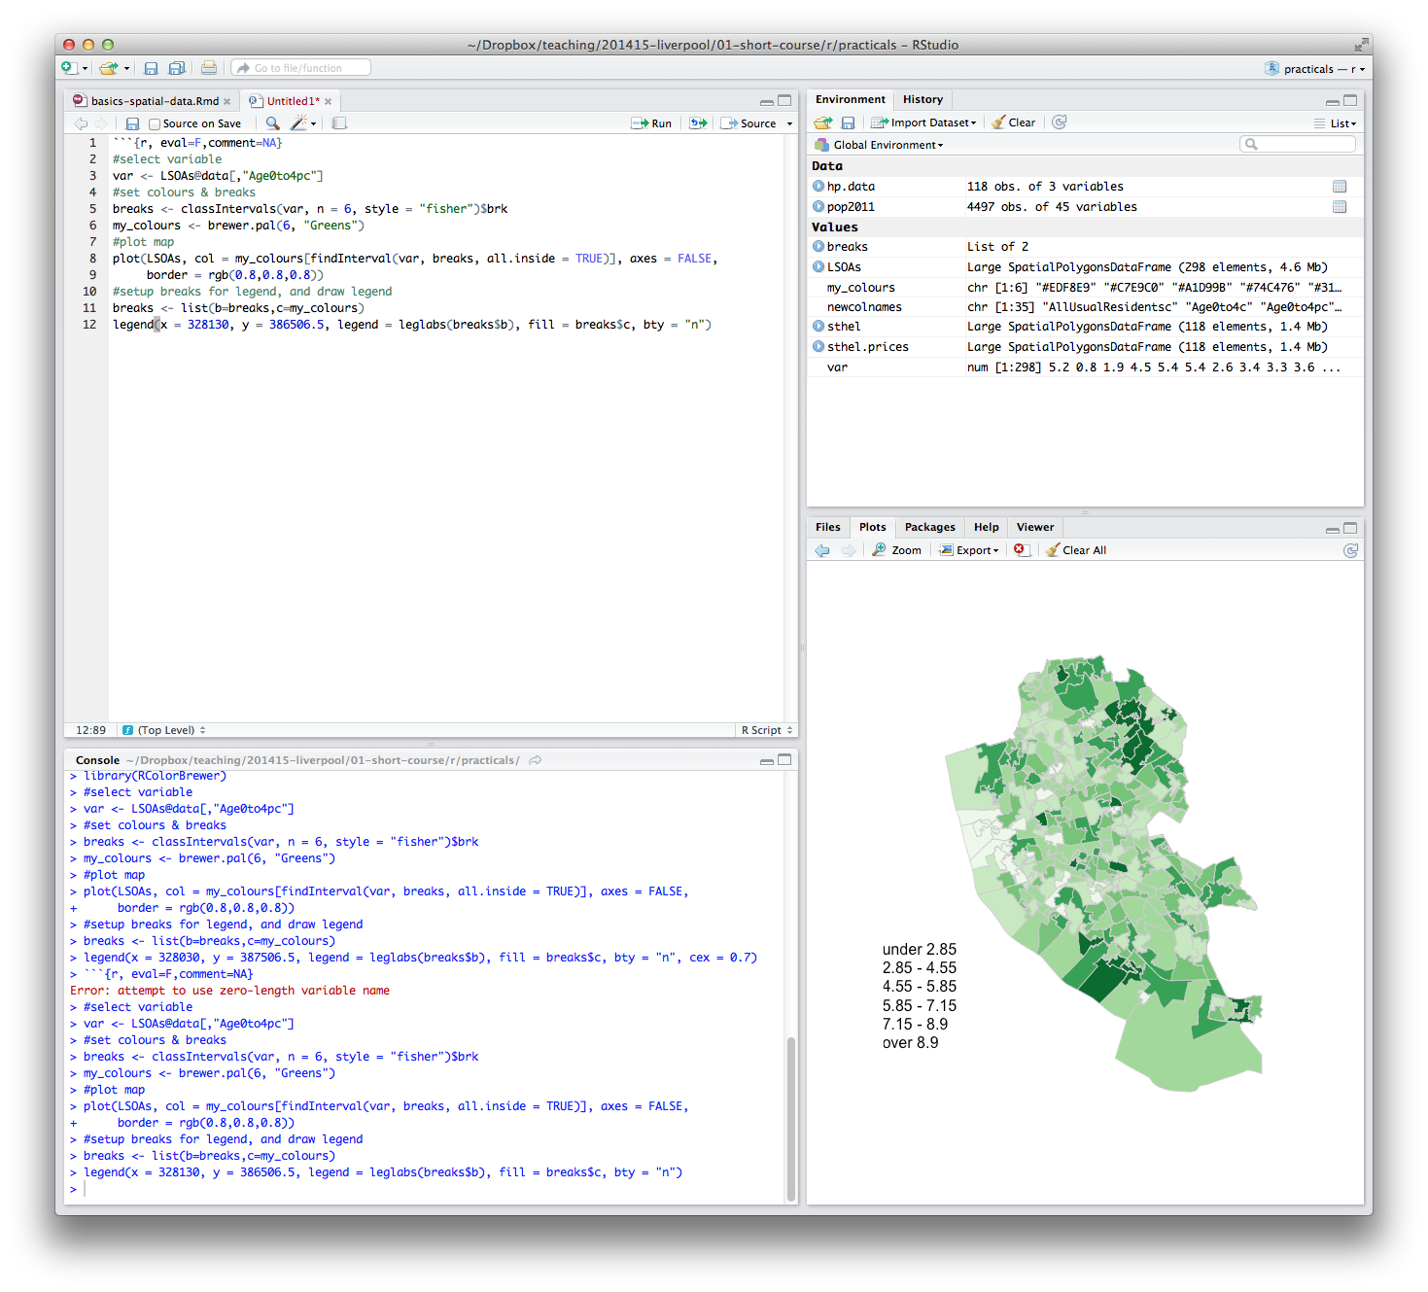
What will you get from the course?
Intros
Background on R and spatial data
Load spatial data
Basic spatial analysis

Slide 3
What will you get from the course?
Appropriate methods of visualizing data
Basic analysis
Mapping Problems Discussion
Presentations etc. will be available online

Slide 4
Outline of the day
10:10am – 10:50am – What is GIS & R?
10:50am – 11:15am – P Intro to GIS
11:15am – 11:45am – Classification
11:45am – 12:30pm – P Classification
12:30pm – 1:15pm – Lunch
1:15pm – 2:30pm – P Making Maps
2:30pm – 2:45pm – Coffee
2:45pm – 3:30pm – P Analysis
3:30pm - 4pm – Mapping Discussion

Slide 5
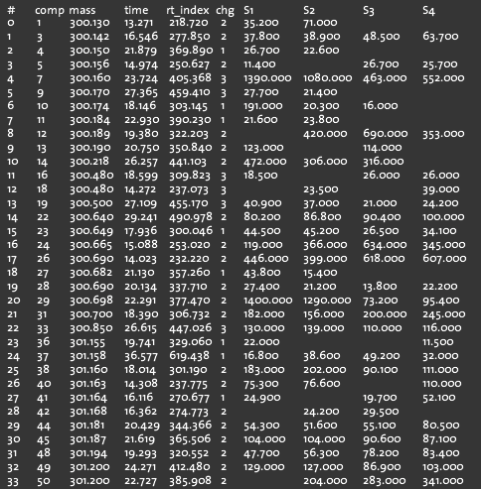
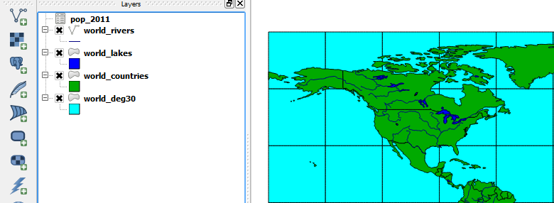
What is GIS?
Turning (spatial) data into information
Using this information to answer questions
How have housing conditions changed in the past ten years?
http://www.flickr.com/photos/dsleeter_2000/3097476532 & ESRI Course “Teaching with GIS”

Slide 6

What is GIS?
Turning (spatial) data into information
Using this information to answer questions
How have housing conditions changed in the past ten years?
http://www.flickr.com/photos/dsleeter_2000/3097476532 & ESRI Course “Teaching with GIS”

Slide 7
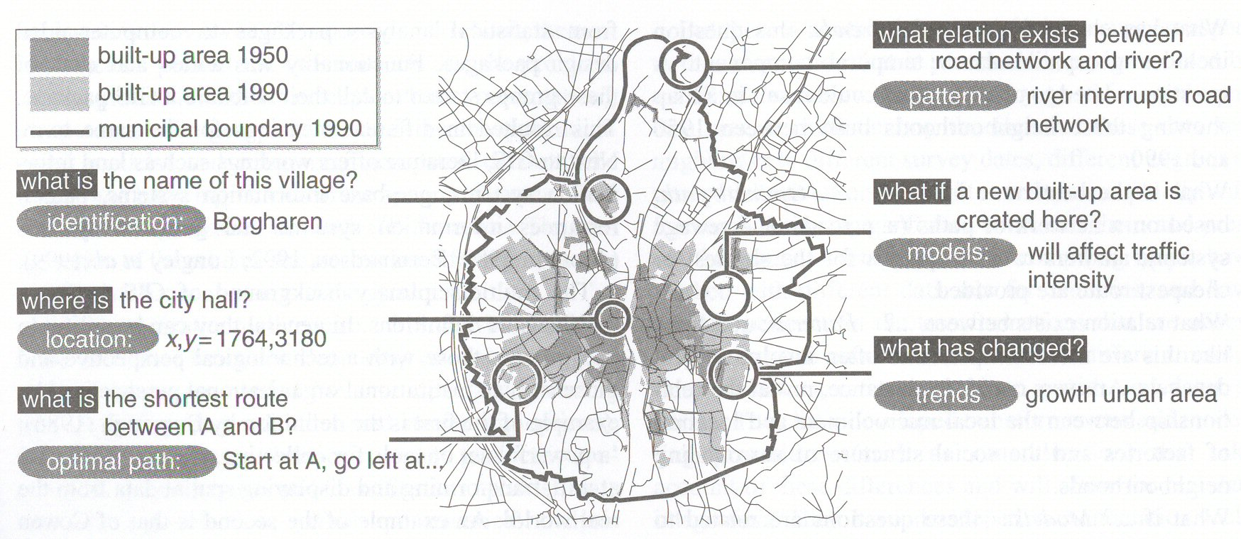
Types of questions a GIS can answer
Source: Kraak & Ormeling (2003) p.7.
Notes:
We can use a GIS for an almost infinite range of purposes, including…
-Location-based queries (e.g. where is the community centre?)
Relationship-based queries (e.g. where is the nearest Well or bore hole?)
Network analysis (e.g. what is the shortest route between A and B?)
Trend analysis (e.g. how has land use changed between time A and time B?)
3D visualisation (e.g. displaying 3d flood models)
This course will give you experience in using all three levels of using geographic information systems.

Slide 8
GIS – Geographic Information Systems
Almost all human activities and decisions involve an important geographic component
the ‘where?’
Working with geographic information involves unique, complex and difficult choices
Why we need specialized software
organize and store
access and retrieve
manipulate and synthesize
apply to the solution of problems

Slide 9
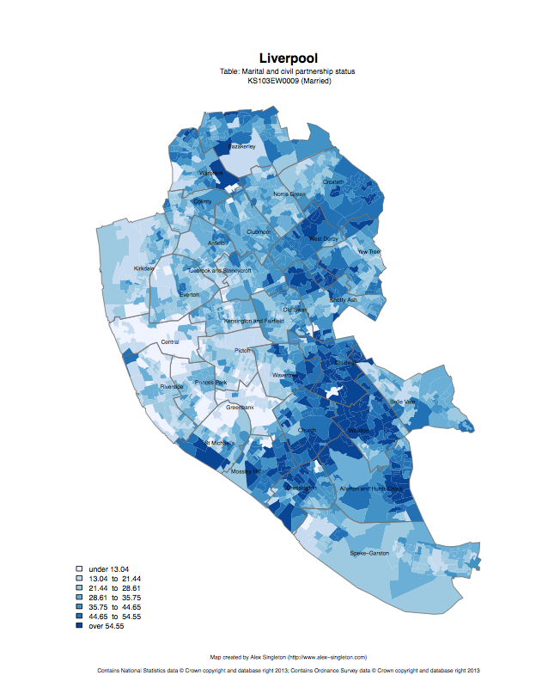
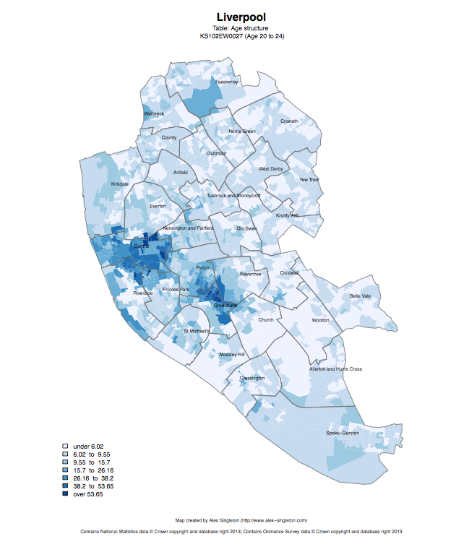
Census 2011
Married
Age structure – 20 to 24
http://www.alex-singleton.com/r/2014/02/05/2011-census-open-atlas-project-version-two/

Slide 10
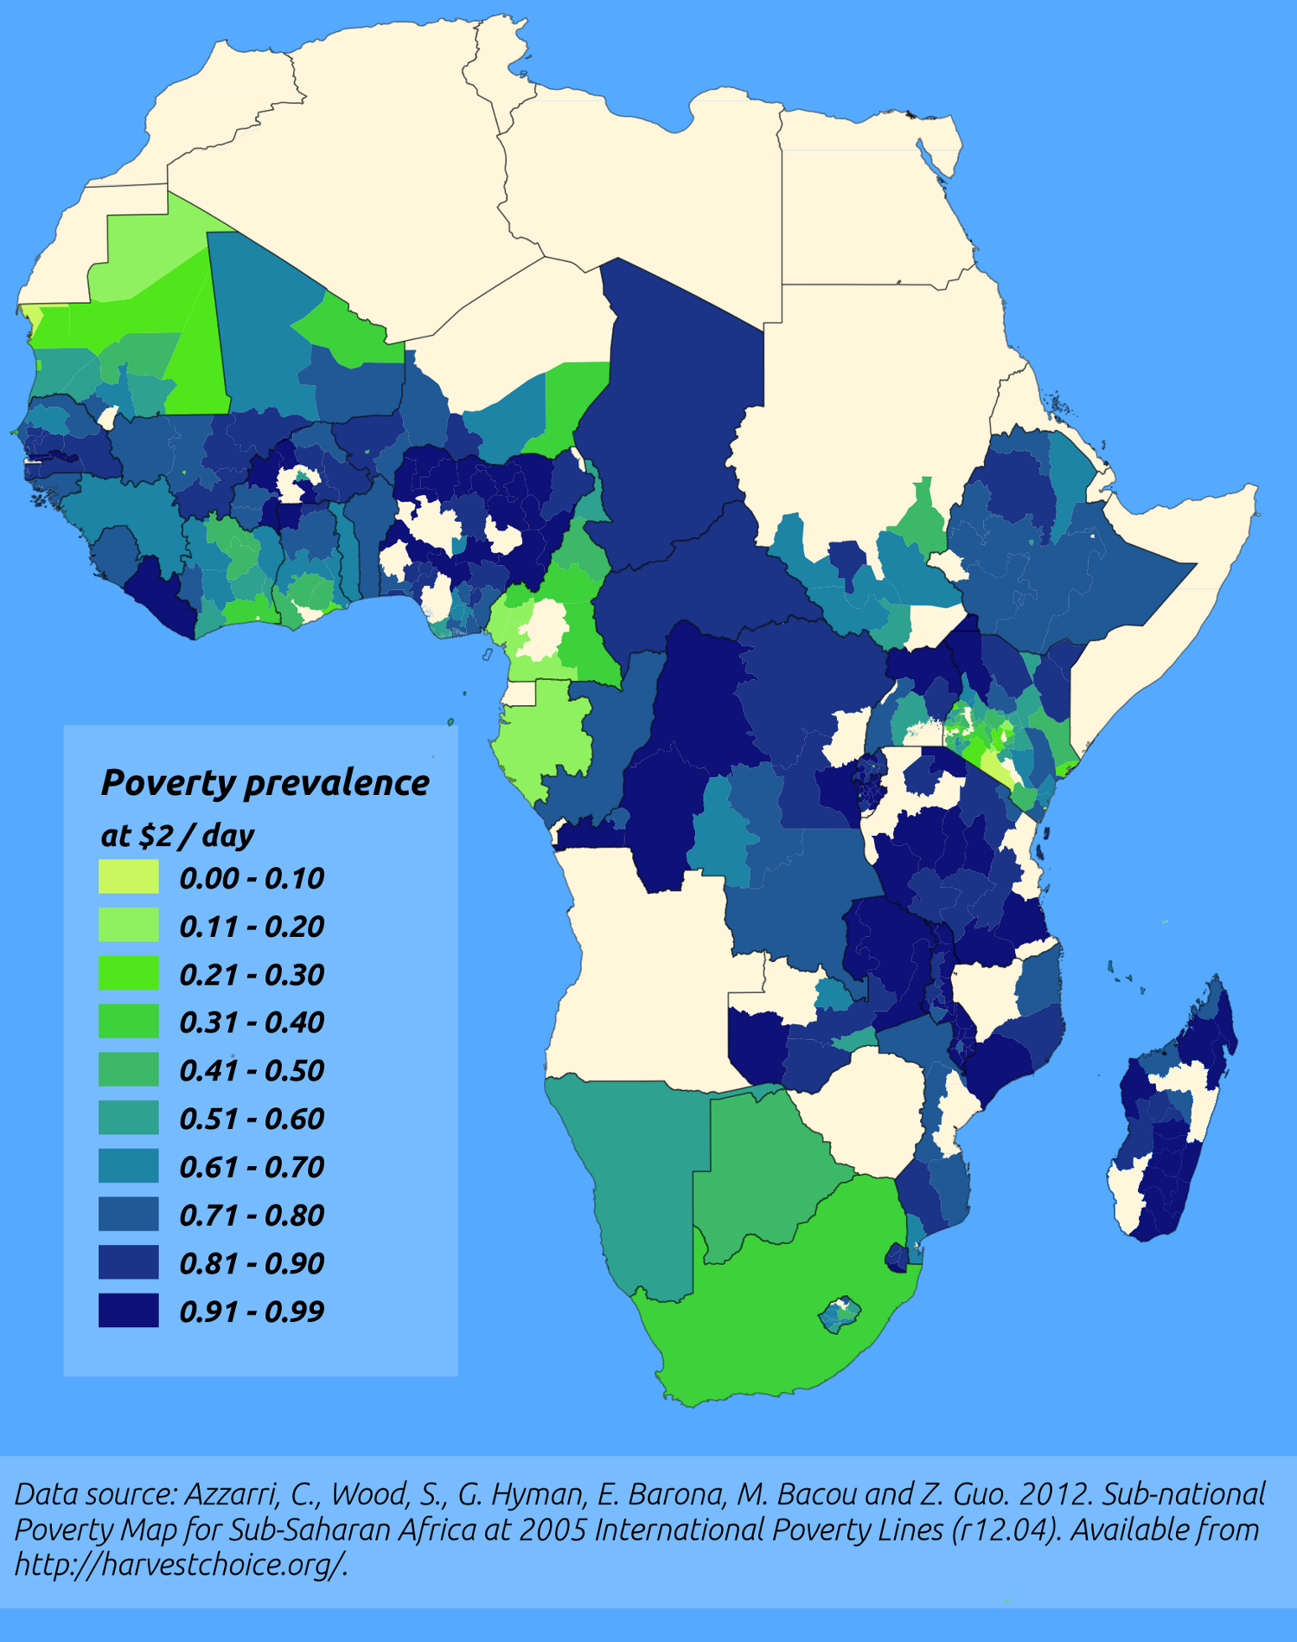
http://pvanb.wordpress.com/2012/05/09/poverty-maps-on-harvestchoice/

Slide 11
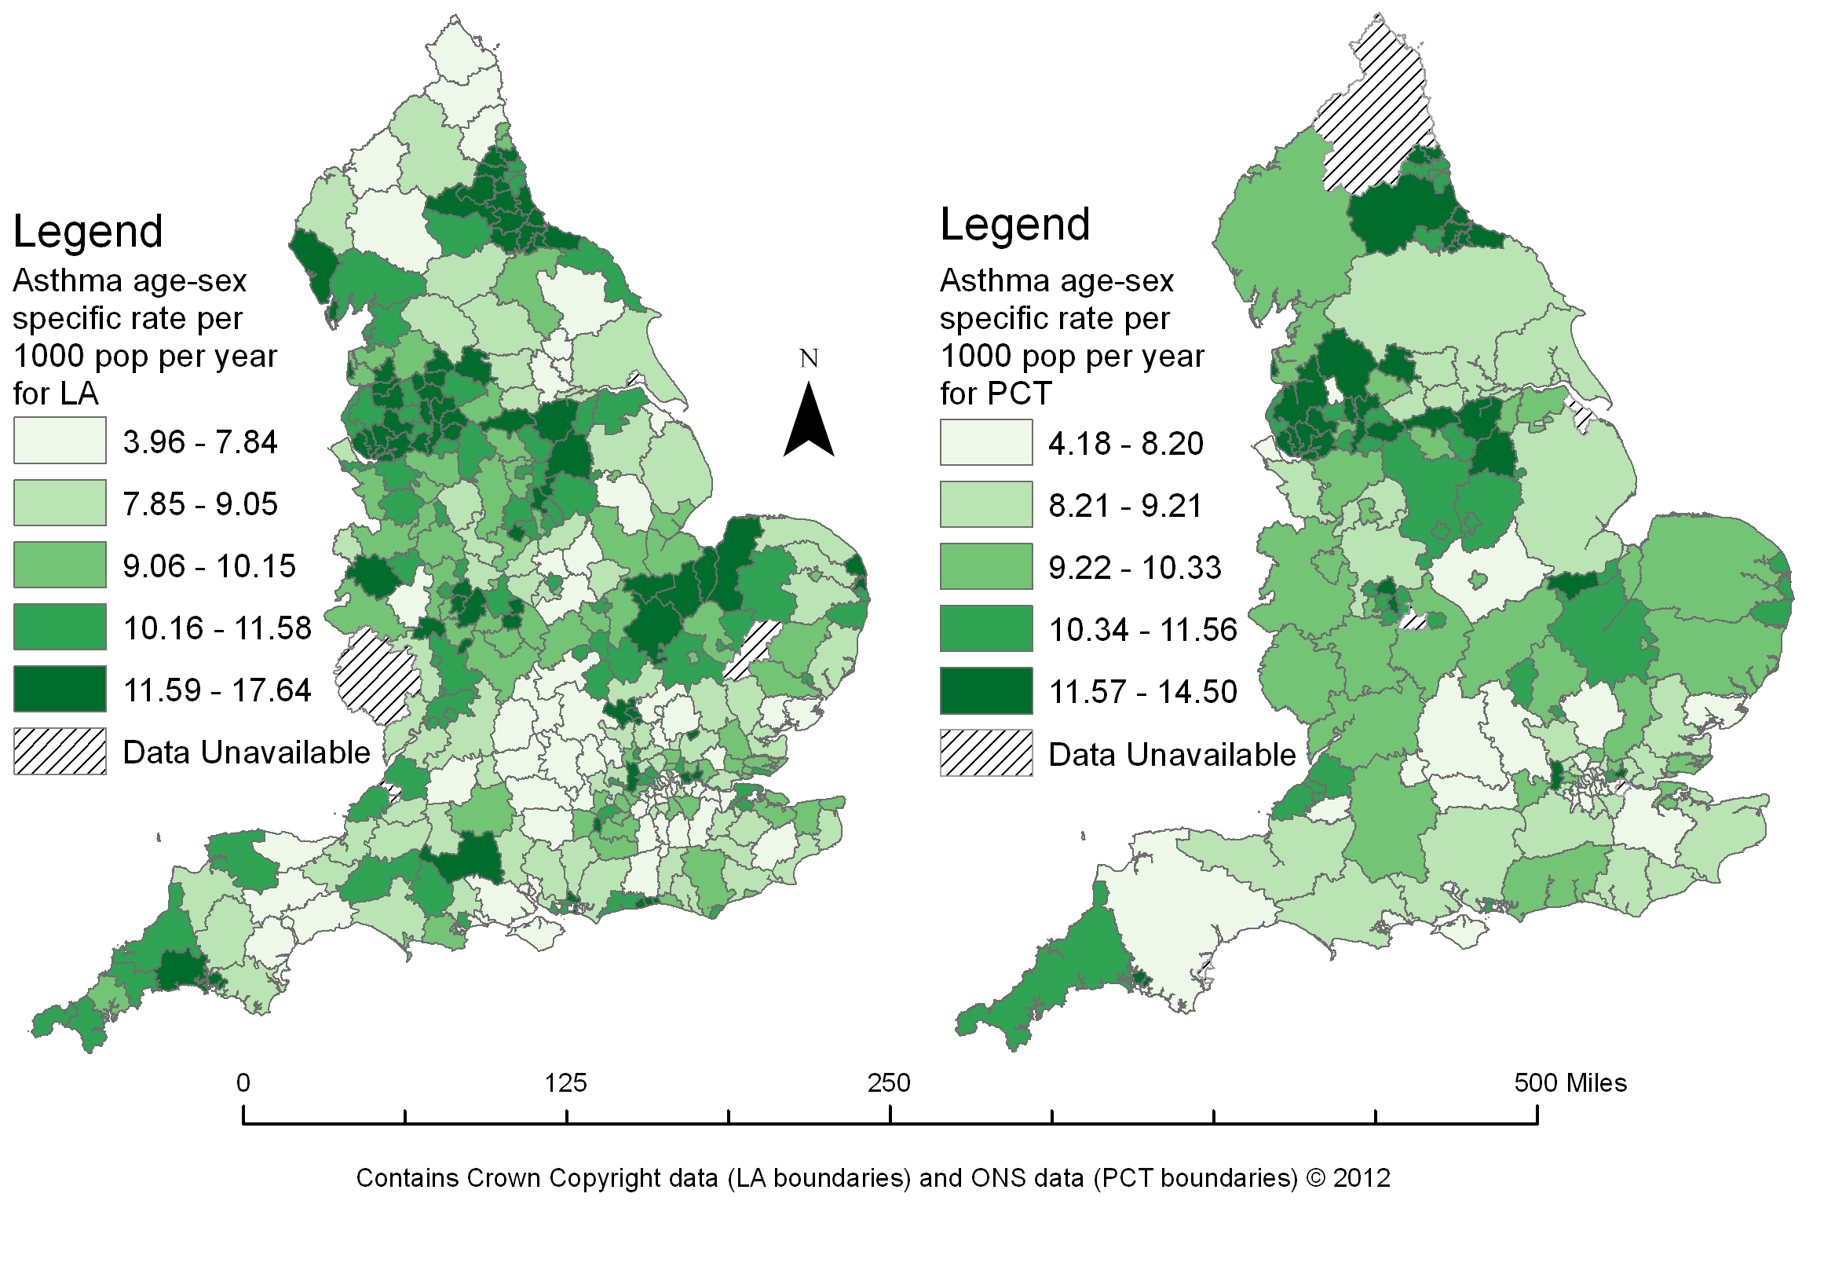

Slide 12
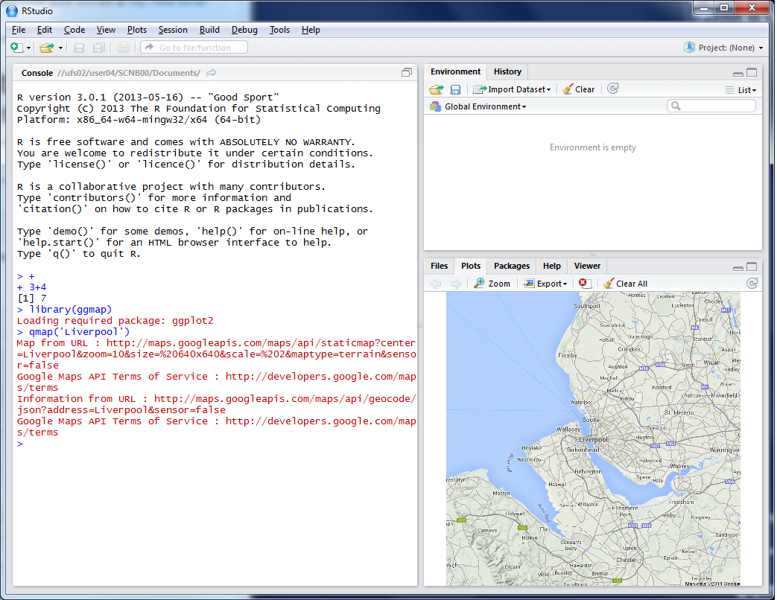


R as a GIS
Command line driven, rather than GUI
Disadvantages
Remembering commands
glossary
Steeper learning curve

Slide 13
R as a GIS
Advantages
Easy to record what you did and repeat specific pieces of work
Lots of reproducible examples on the web
Easily scriptable.
134,567 maps? easy!
2011 Census Open Atlas
http://www.alex-singleton.com/r/2014/02/05/2011-census-open-atlas-project-version-two/

Slide 14
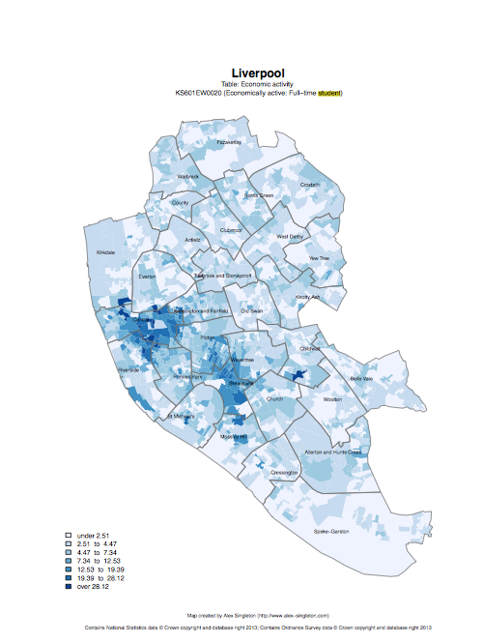

R in Action
Economically active – Full-time students

Slide 15
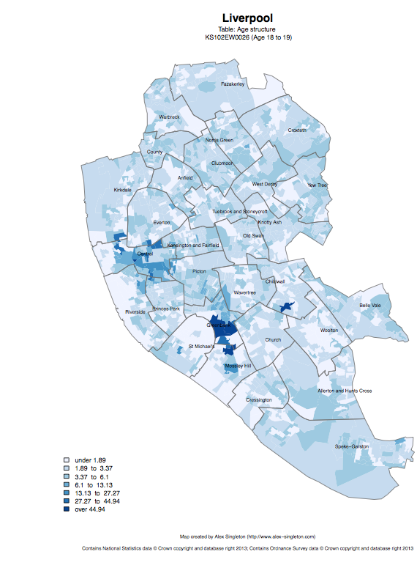
Age structure – 18 to 19
Age structure – 20 to 24

Slide 16
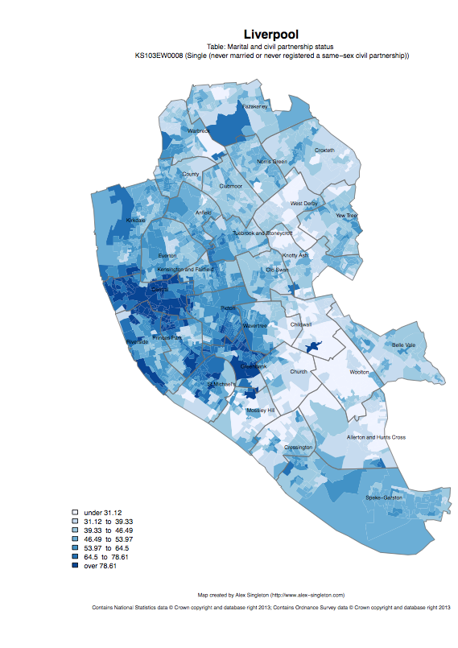
Single
Married

Slide 17
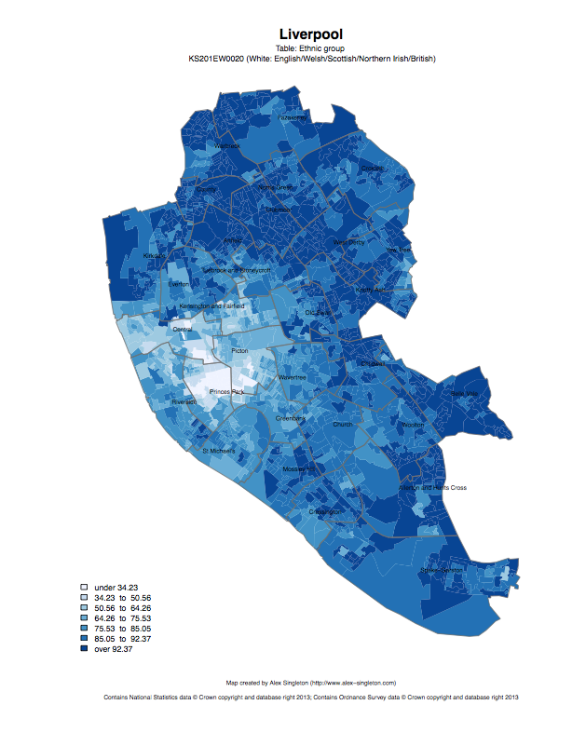
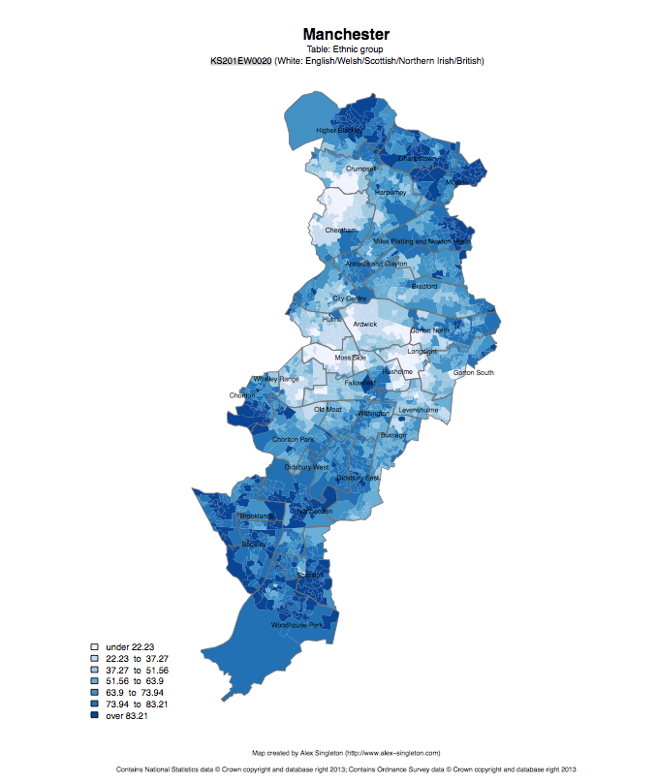
Ethnic group: white

Slide 18
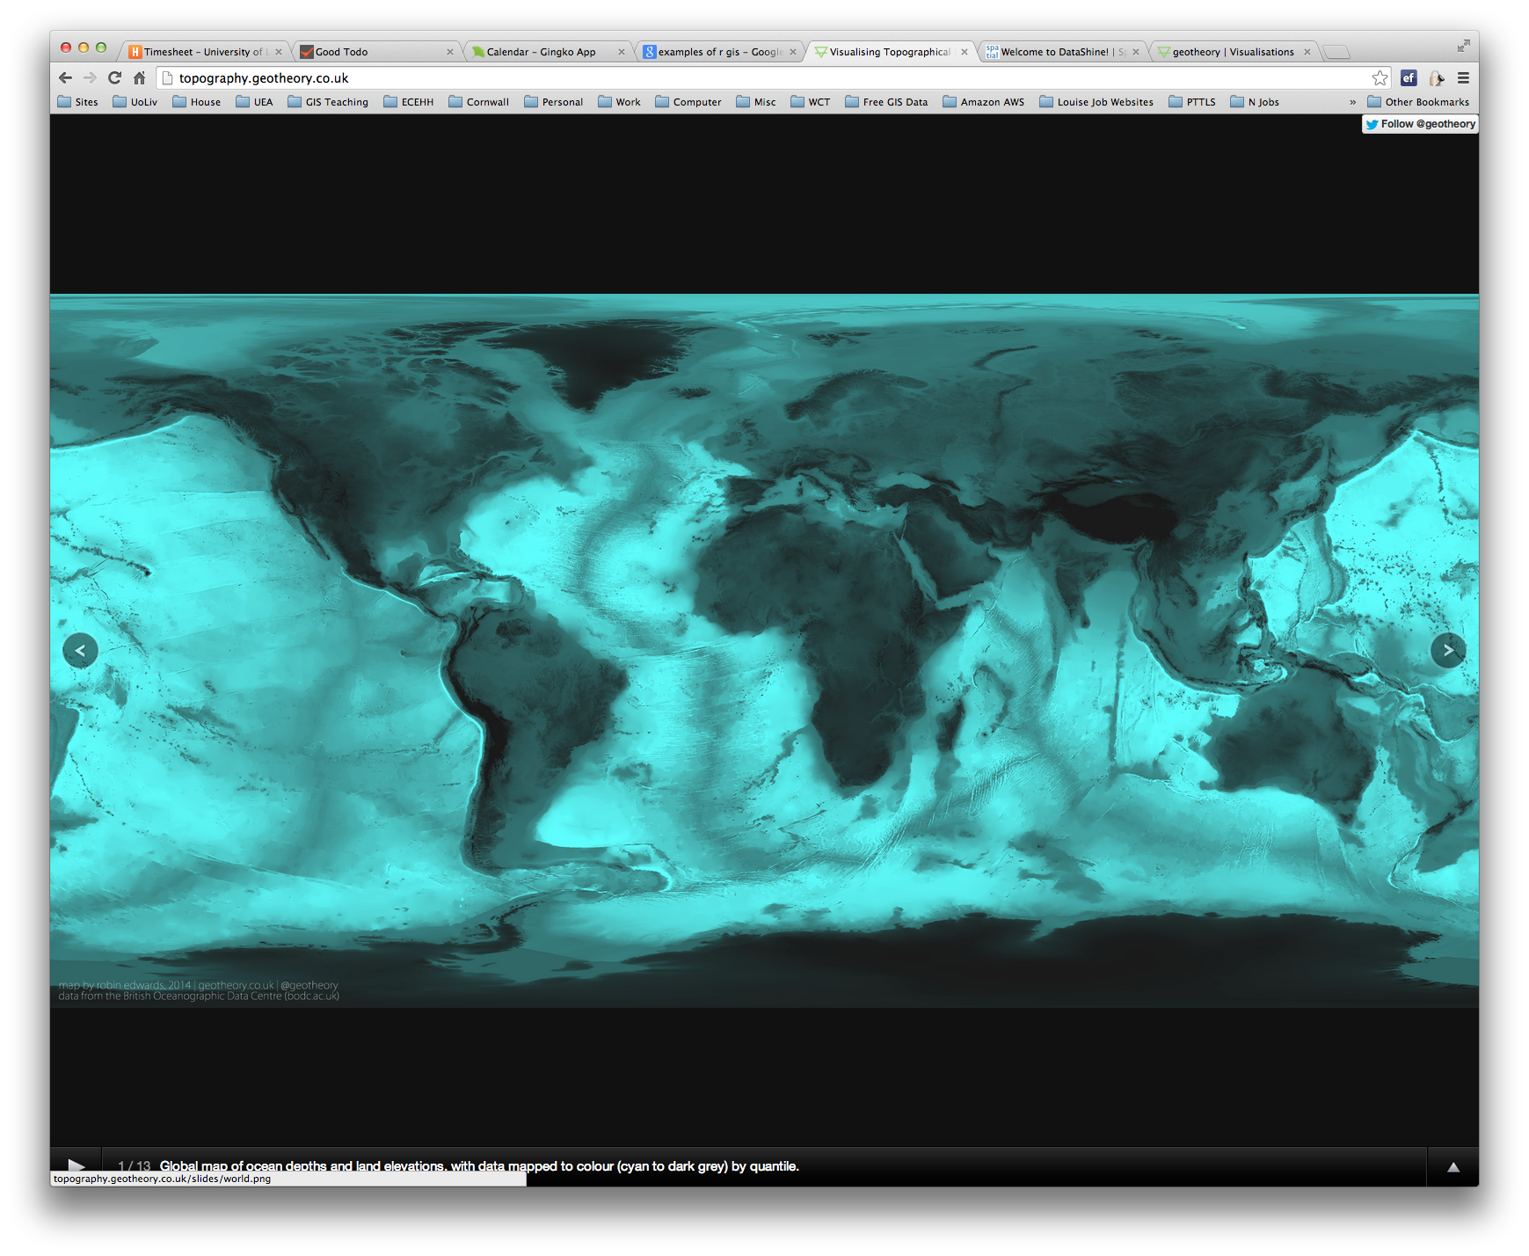
R as a GIS
Topography
http://topography.geotheory.co.uk/

Slide 19
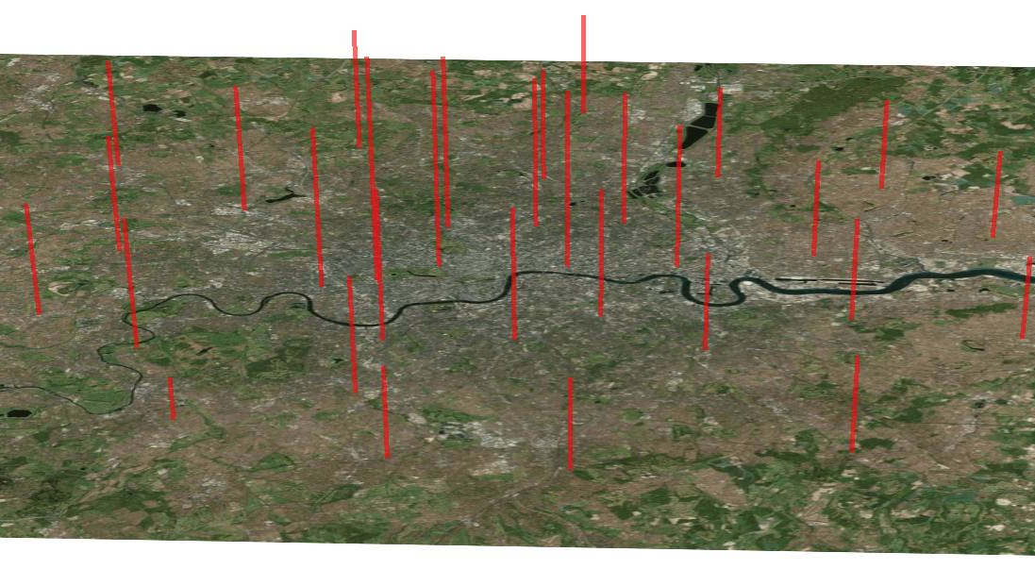
3D Mapping – London’s rental costs
http://spatial.ly/2013/05/3d-mapping-r/

Slide 20




Other GIS software?
R is very different to ArcGIS, but can do many of the same operations
R is free (as is QGIS)
R is increasingly popular in academic sector
All can be useful

Slide 21
Projections and Coordinate Systems
Who has heard of these?
Why are they important?
Latitude and Longitude (WGS 1984) 52°N 37’ 30.32’’ (52.6250) 1°E 14’ 2.05’’ (1.2339) British National Grid (Eastings & Northings) Easting: 619301 Northing: 307416

Slide 22
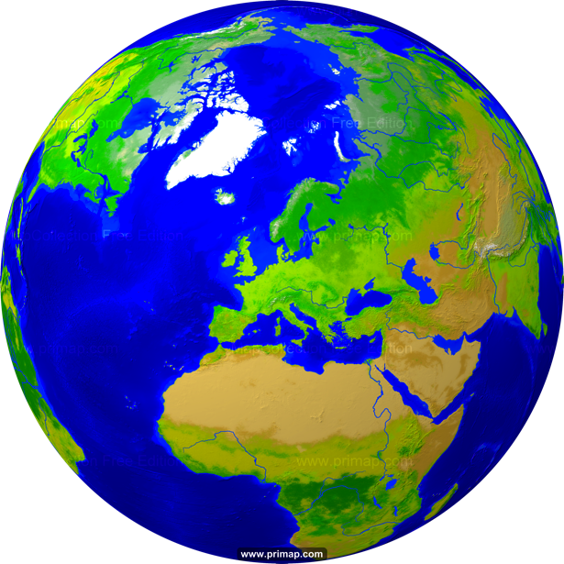
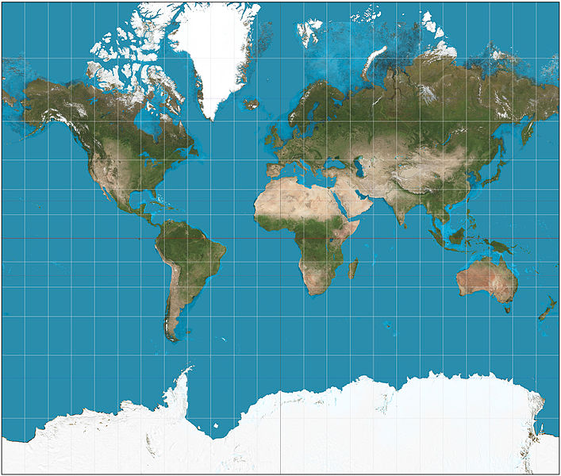
Projections
Projection – going from a sphere to a flat surface
http://www.primap.com/wsen/Maps/MapCollection/WorldMaps/Globe-(Europe-centered)-Vegetation-4000x4000.html

Slide 23


Projections
Projection – going from a sphere to a flat surface
http://krygier.owu.edu/krygier_html/geog_353/geog_353_lo/geog_353_lo05.html
http://www.hdwallpapersos.com/orange-fruit-hd-wallpapers.html

Slide 24
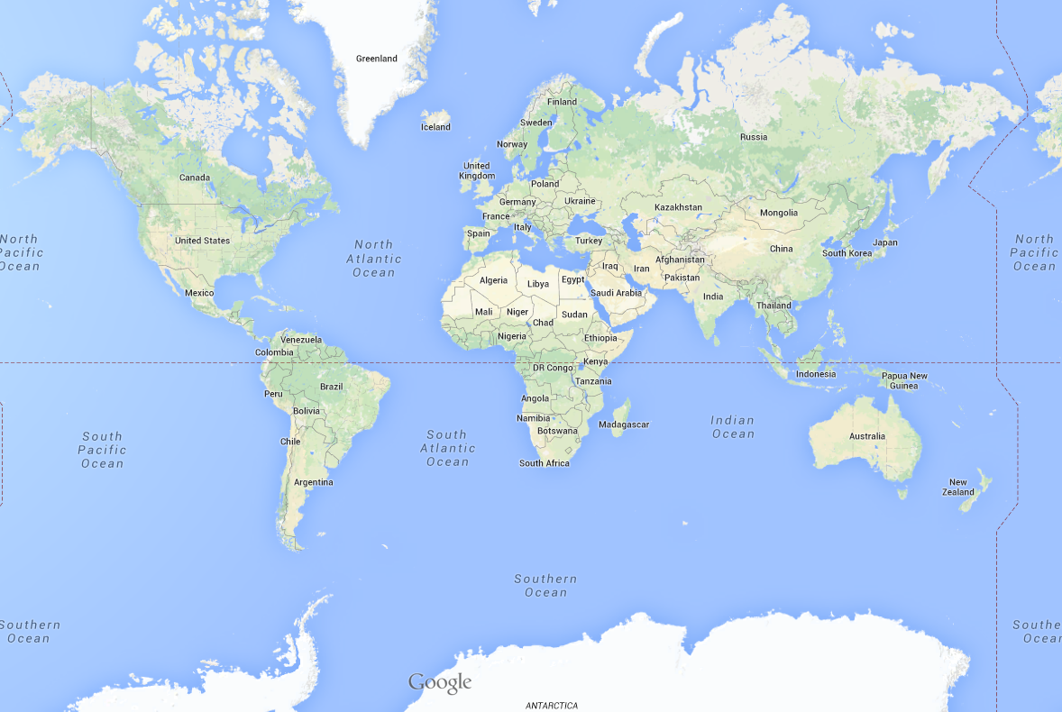
This file is licensed under the Creative Commons Attribution-Share Alike 3.0 Unported license. http://en.wikipedia.org/wiki/File:Mercator_projection_SW.jpg
Mercator projection

Slide 25
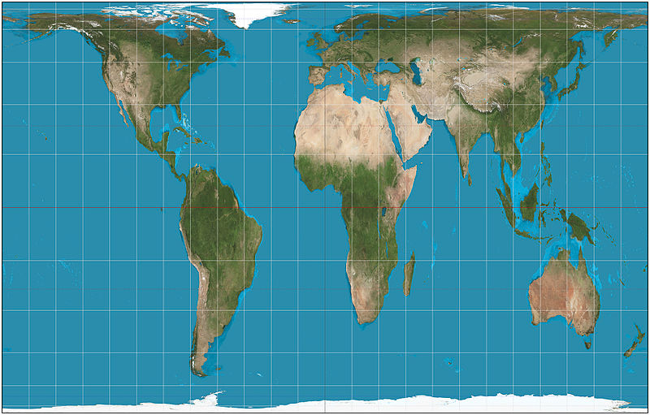
This file is licensed under the Creative Commons Attribution-Share Alike 3.0 Unported license. http://en.wikipedia.org/wiki/File:Mercator_projection_SW.jpg
Mercator projection
Peters projection
This file is licensed under the Creative Commons Attribution-Share Alike 3.0 Unported license. http://en.wikipedia.org/wiki/File:Gall%E2%80%93Peters_projection_SW.jpg

Slide 26
Africa: 30 million sq km
Greenland: 2 million sq km

Slide 27
Projections etc.
Africa: 30 million sq km
Greenland: 2 million sq km

Slide 28
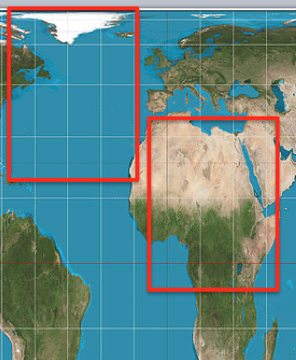
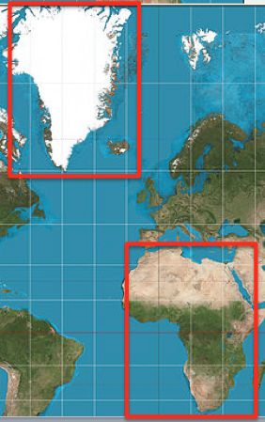
Why are Projections important?
The map(s) may not be as they appear
Data may appear in the wrong place

Slide 29
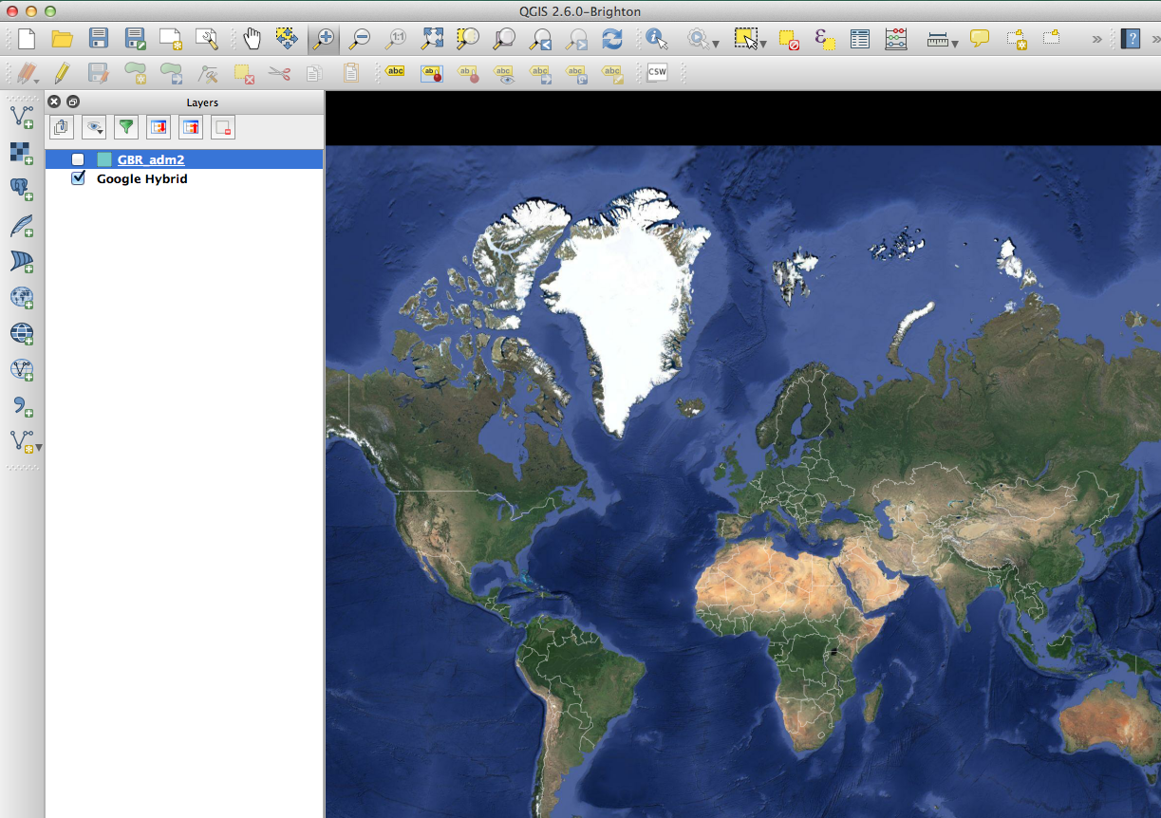

Slide 30
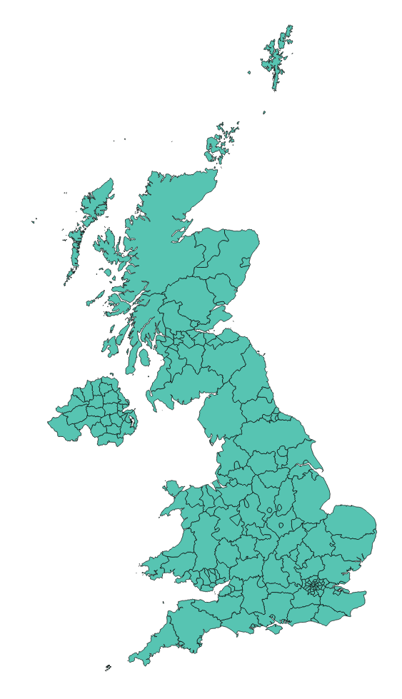

Slide 31
Why are Projections important?
The map(s) may not be as they appear
Data may appear in the wrong place
Coordinate Systems

Slide 32
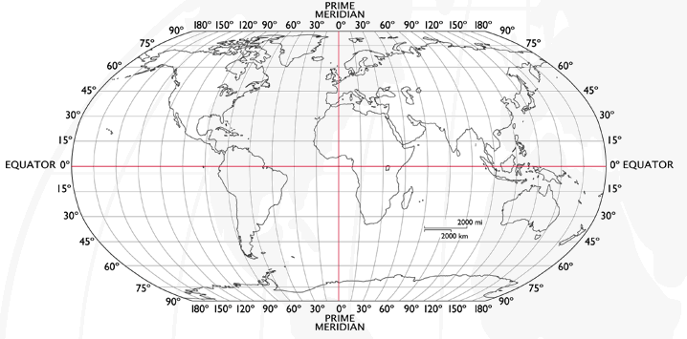
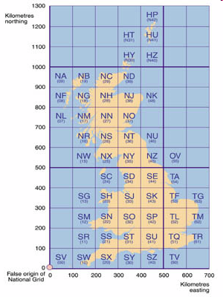
Coordinate Systems
Latitude and Longitude (WGS 1984) EPSG = 4326
52°N 37’ 30.32’’ (52.6250) 1°E 14’ 2.05’’ (1.2339)
British National Grid (Eastings & Northings)
Easting: 619301 Northing: 307416 EPSG = 27700
Why is it important?
Some data uses uses WGS84
LSOA use BNG (Eastings/Northings)
Need to convert between the two
Notes:
-Coordinate Systems are derived from projections and are used to give coordinates (numbers) to locations on the Earth’s surface
-Best if your data is all in the same coordinate system (otherwise the coordinates might be slightly different for the same location), but ArcMap can convert between them
-Most common:
-Lat/Long (also WGS 1984) used by most GPS
-BNG (British National Grid) very common in UK data – Ordnance Survey format.
-Most important – are all your data in the same coordinate system?
-ArcMap can convert, but often if your data appears in the wrong place, it is because there is something wrong with the coordinate system.
http://www.worldatlas.com/webimage/testmaps/latslongs.htm
http://www.ordnancesurvey.co.uk/oswebsite/gps/information/coordinatesystemsinfo/guidetonationalgrid/page13.html
http://www.ordnancesurvey.co.uk/oswebsite/gps/information/coordinatesystemsinfo/guidetonationalgrid/page8.html

Slide 33
Joining
Area ID
1
2
3
4
5
14
7
8
11
Area ID | Deprivation
1 | High
2 | High
3 | High
4 | Average
5 | Average
6 | Average
7 | Low
8 | Low
9 | Low
10 | High
11 | Low
12 | High
13 | High
14 | Average
15 | Average
1
2
3
14
4
7
5
8
11
Data
Polygons
Lookup

Slide 34
1
Area ID | Deprivation
1 | High
2 | High
3 | High
4 | Average
5 | Average
14 | Average
7 | Low
8 | Low
11 | Low
2
3
14
4
7
5
8
11
High Deprivation
Average Deprivation
Low Deprivation

Slide 35
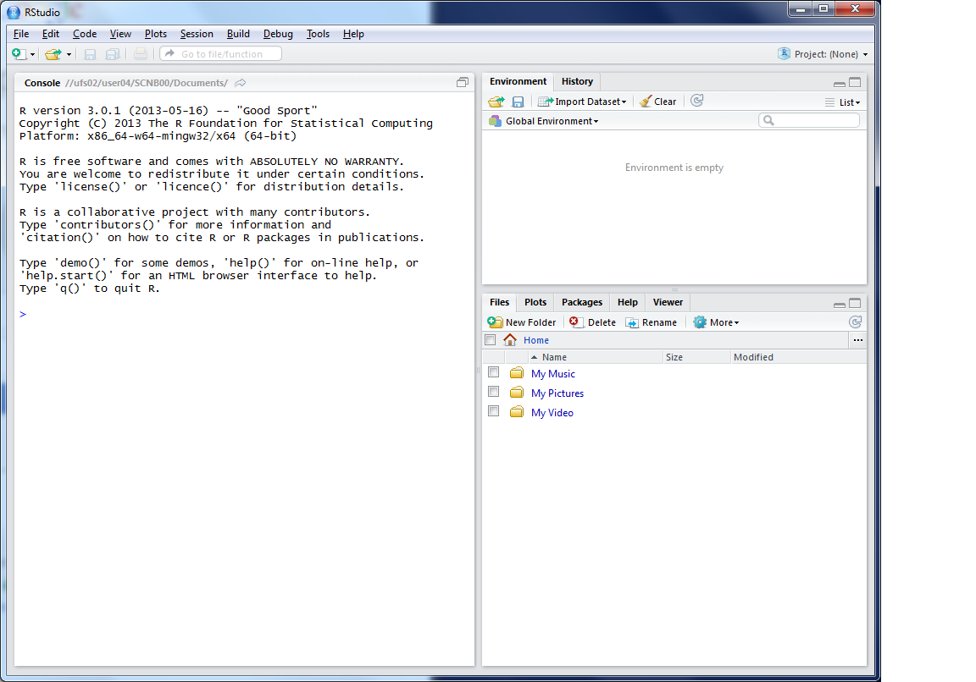
This lists the variables you have
This is the console where you can type in commands
Here will show either your files (the files tab) or your plots (the plots tab)

Slide 36
Working Directory
R uses a ‘working directory’ to store your files in
You might have a different one for each project / piece of work
e.g. M:\Documents\GIS
setwd(“M:/Documents/GIS”)

Slide 37
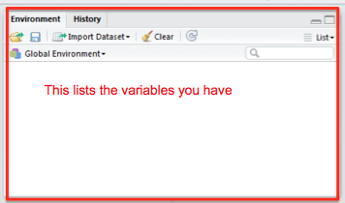
Variables
R uses variables to store information – listed in your ‘workspace’ (top-right)
When you close R Studio, save workspace
house.prices <- c(120,150,212, 99,199,299,159)

Slide 38
Variables and Assignments
house.prices
<-
c(120,150,212,99,199,299,159)

Slide 39
Variables and Assignments
house.prices
<-
c(120,150,212,99,199,299,159)

Slide 40
Variables and Assignments
house.prices
<-
c(120,150,212,99,199,299,159)

Slide 41
Variables and Assignment
motorways
<-
readShapeSpatial('meridian-2/ motorway_polyline’, proj4string = CRS("+init=epsg:27700"))
See glossary for details

Slide 42
Variables and Assignment
motorways
<-
readShapeSpatial('meridian-2/ motorway_polyline’, proj4string = CRS("+init=epsg:27700"))
See glossary for details

Slide 43
Variables and Assignment
motorways
<-
readShapeSpatial('meridian-2/ motorway_polyline’, proj4string = CRS("+init=epsg:27700"))
See glossary for details

Slide 44
Variables and Assignment
motorways
<-
readShapeSpatial('meridian-2/ motorway_polyline’, proj4string = CRS("+init=epsg:27700"))
See glossary for details
Case sensitive
Motorways ≠ motorways ≠ mOtOrWaYs

Slide 45
Typing out Code
Log on
Why do I make you type out code?
Helps the learning process
Make you think about what the code does
(but you can copy/paste long bits)
Optional Exercises
Red and Green post-its
Breaks

Slide 46
R follow on screen
Load R Studio
Explain window parts
Typing 3+4 into console

Slide 48
Outline of the day
10:10am – 10:50am – What is GIS & R?
10:50am – 11:15am – P Intro to GIS
11:15am – 11:45am – Classification
11:45am – 12:30pm – P Classification
12:30pm – 1:15pm – Lunch
1:15pm – 2:30pm – P Making Maps
2:30pm – 2:45pm – Coffee
2:45pm – 3:30pm – P Analysis
3:30pm - 4pm – Mapping Discussion

Slide 49
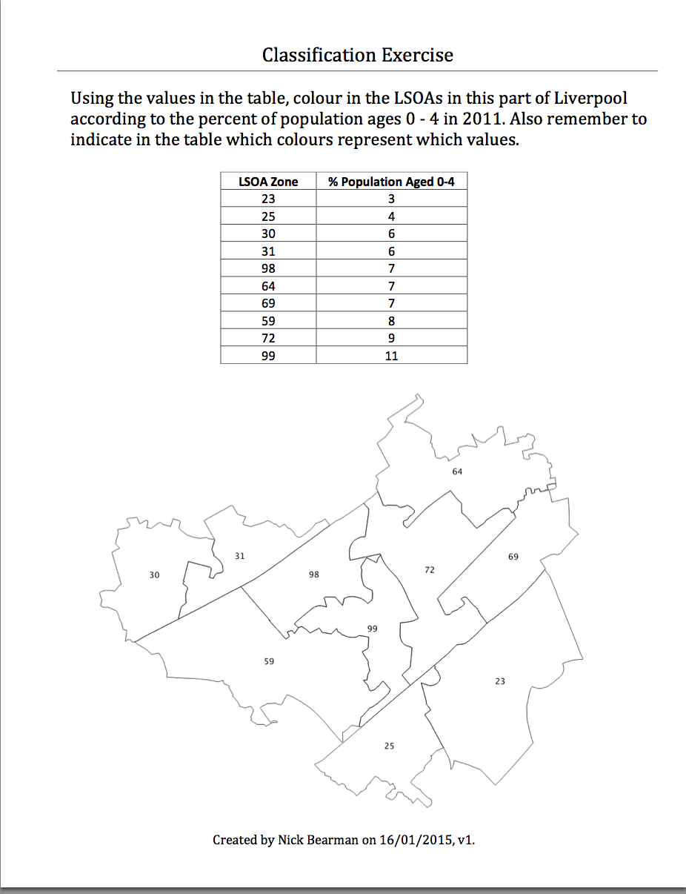
Classification
Colour in the values for Age (10 min)
Discuss your choices

Slide 50
Classification
Colour in the values for Age (10 min)
Discuss your choices
Colours
Classes

Slide 51
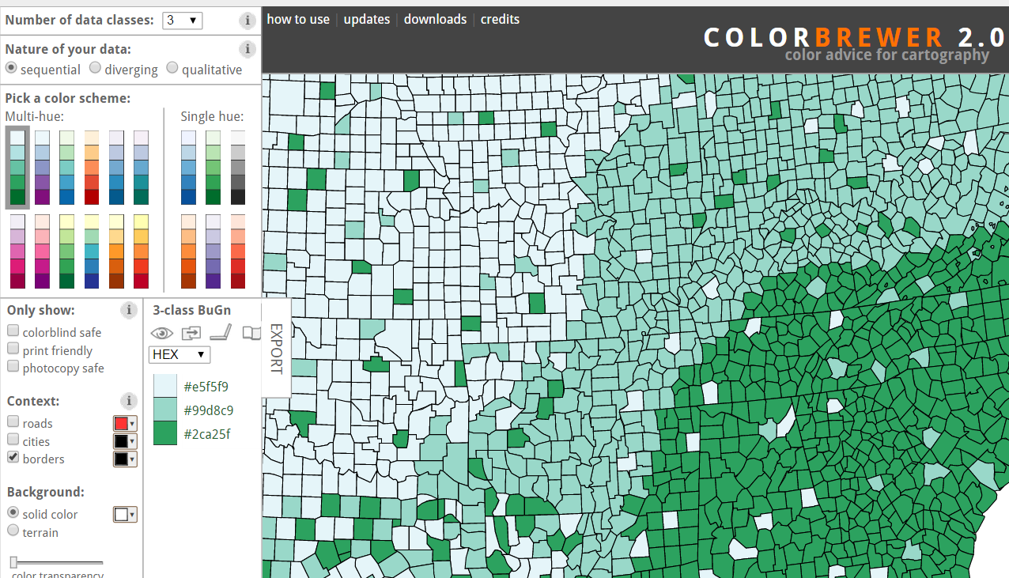
Map Design: Classification
Choropleth maps have colours
How do you choose the colours?
Why is this important?
Output
User
colorbrewer.org

Slide 52
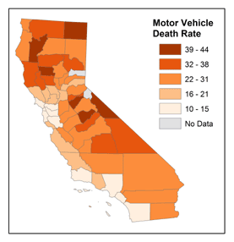
Map Design: Classification
Choropleth maps have classes
How do you choose the classes?
Why is this important?
© 2014 The Pennsylvania State University, https://www.e-education.psu.edu/geog486/l4_p7.html#classification_schemes

Slide 53
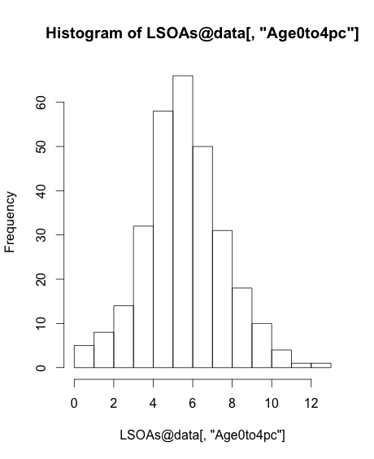
Map Design: Classification
[,"Age0to4pc"]

Slide 54
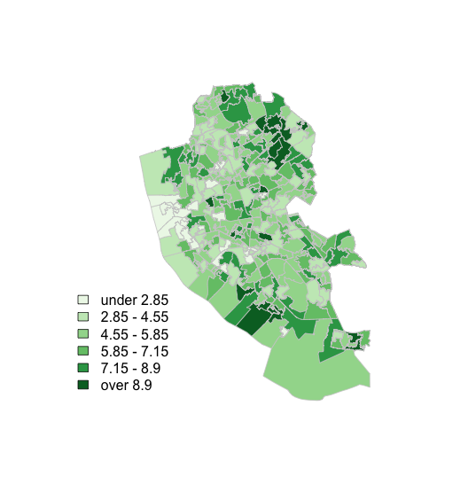
Map Design: Classification

Slide 55
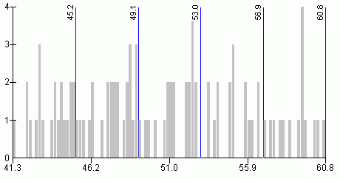
Map Design: Classification
s
http://www.directionsmag.com/entry/choropleth-mapping-with-exploratory-data-analysis/123579

Slide 56
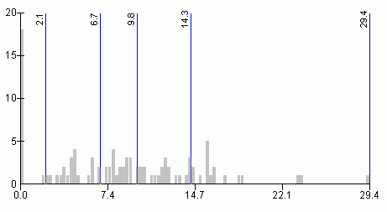
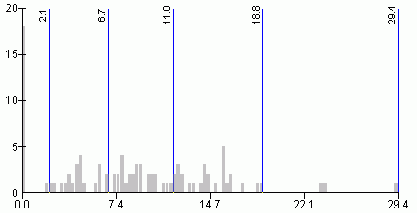
Quantiles
- “equal sized data subsets”
sN
Natural Breaks
reduce variance within class
increase variance between classes
http://www.directionsmag.com/entry/choropleth-mapping-with-exploratory-data-analysis/123579

Slide 57
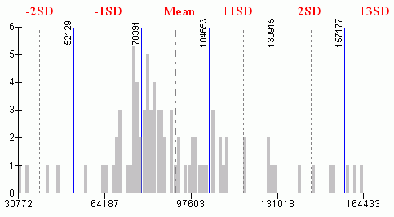
sN
Standard Deviation
R has:
fixed
sd
equal
pretty
quantile
fisher
jenks
….
(from ?classIntervals)
http://www.directionsmag.com/entry/choropleth-mapping-with-exploratory-data-analysis/123579

Slide 58
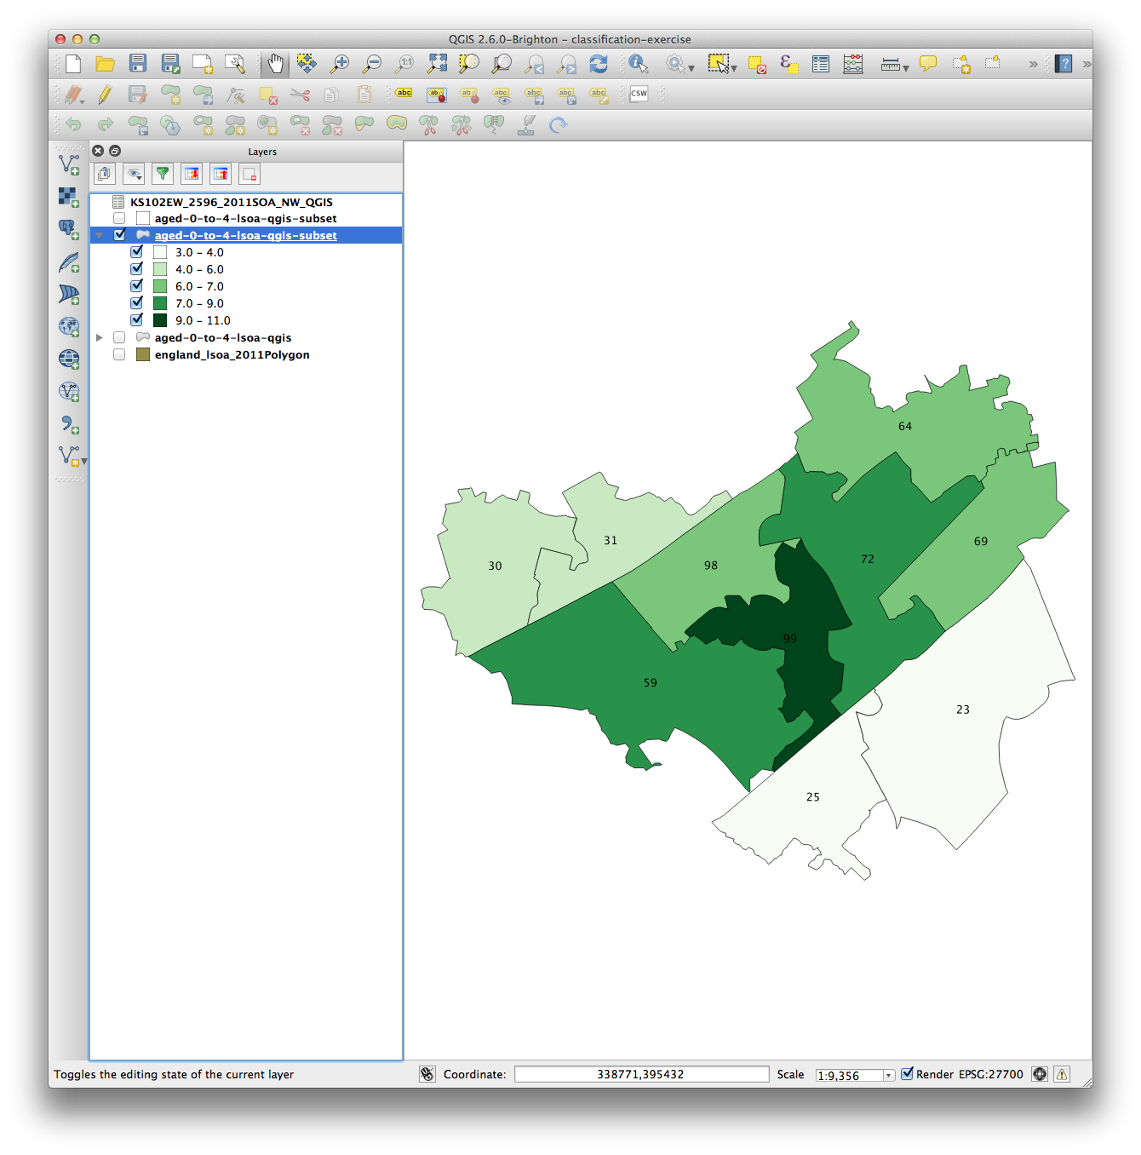
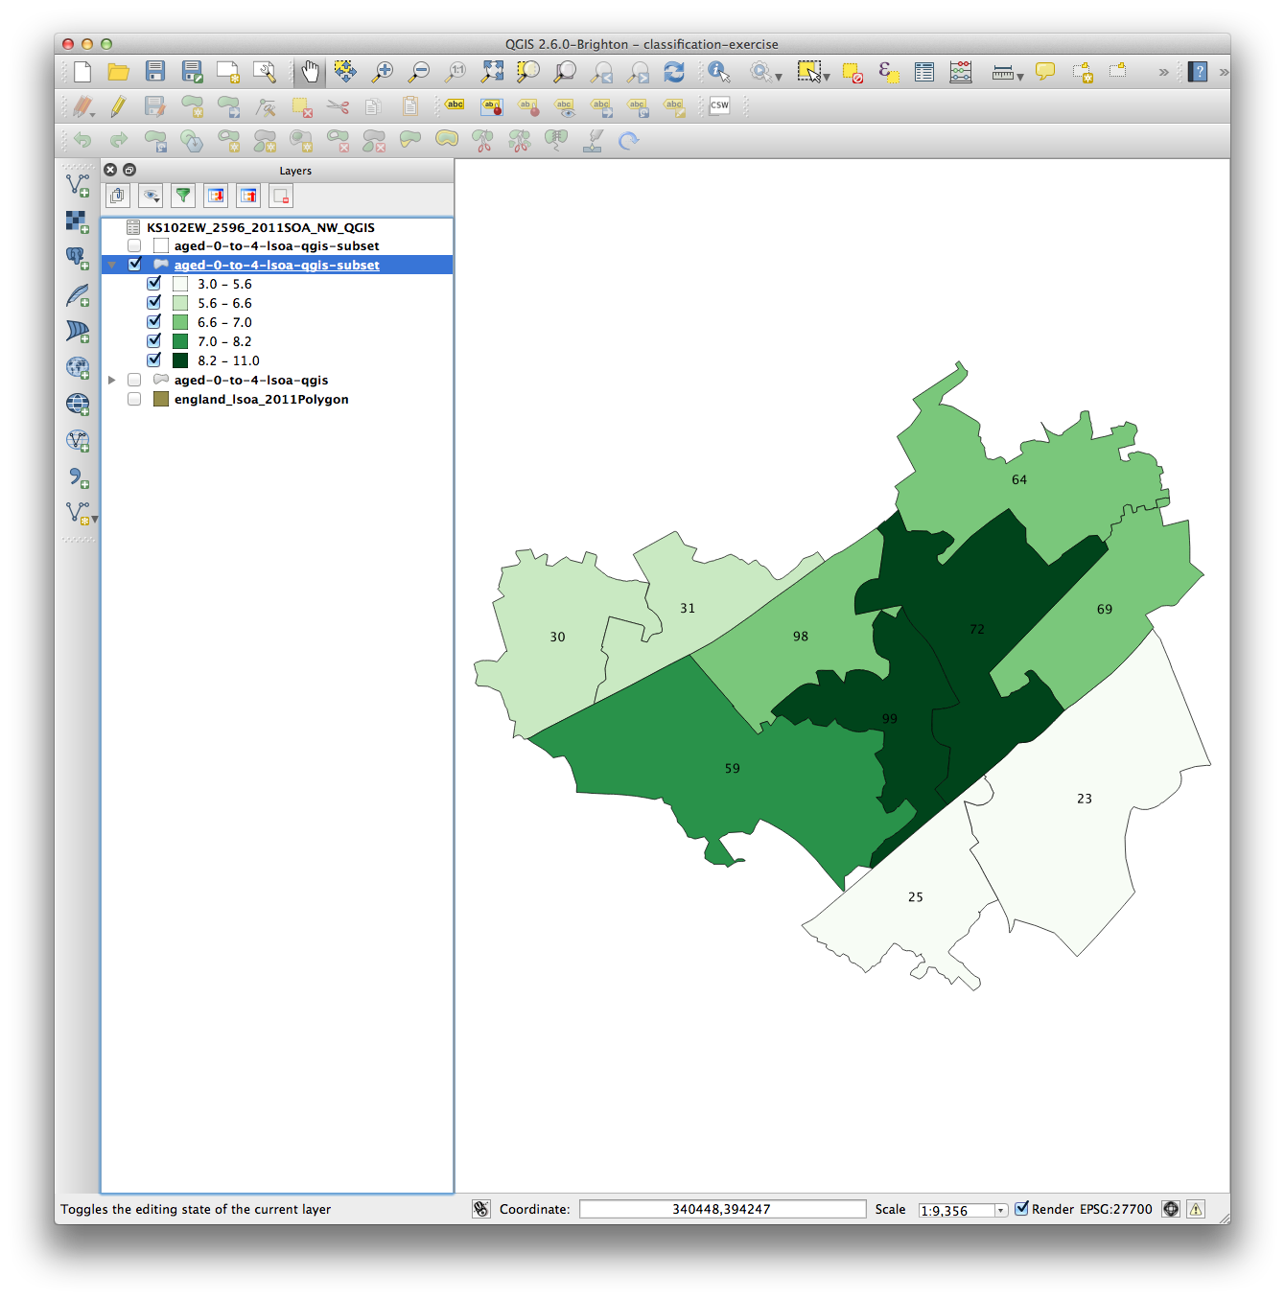
Why is it important?
Age 0-4
Natural Breaks
Quantile

Slide 59
Why is it important?
Age 0-4
Natural Breaks
Quantile

Slide 60
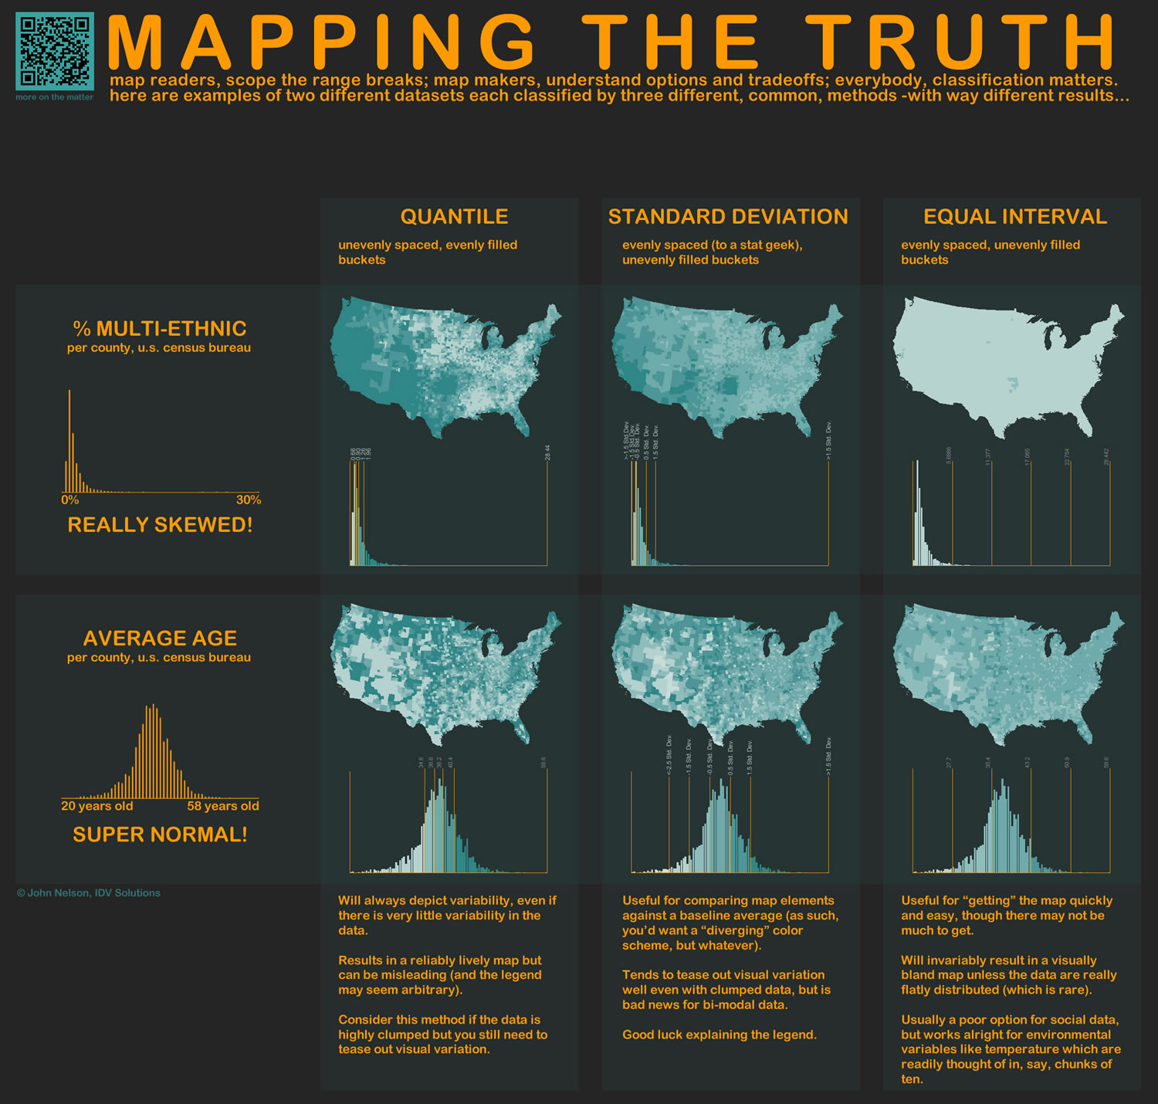
http://www.flickr.com/photos/idvsolutions/6691496421/in/photostream/

Slide 62
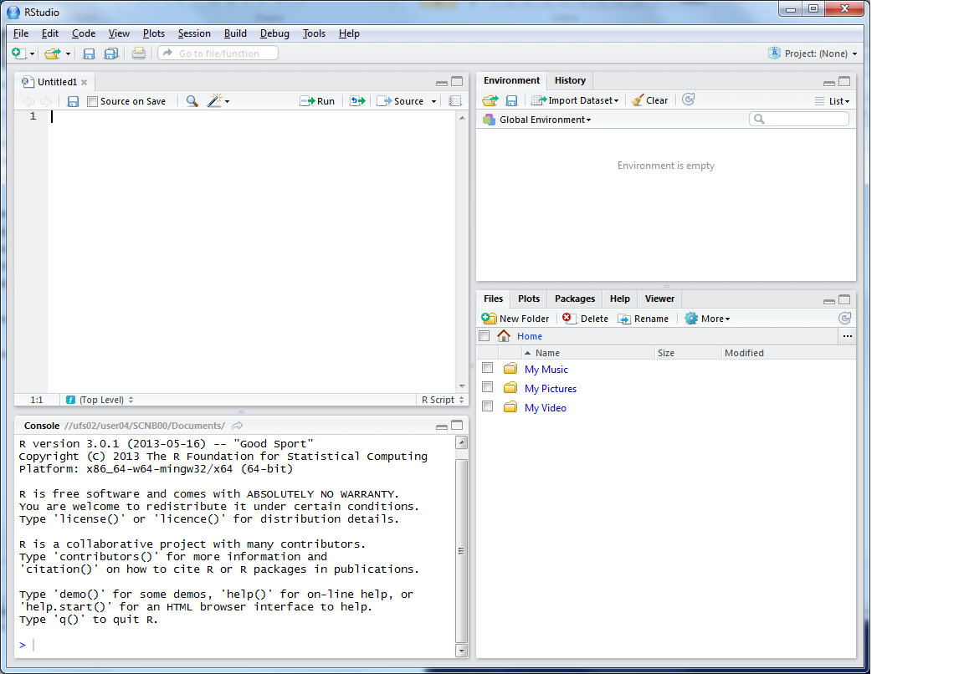
R Scripts
Why use scripts?
Easier to correct code
Can easily re run sections of code, or all code if you need to start again
Good to enable you to reload data etc. if you move machines, or don’t have your workspace saved

Slide 63
This is where you can write scripts
This lists the variables you have
Link to survey:
Here will show either your files (the files tab) or your plots (the plots tab)
This is the console where you can type in commands

Slide 64
Ctrl-Enter to run line/selection

Slide 65
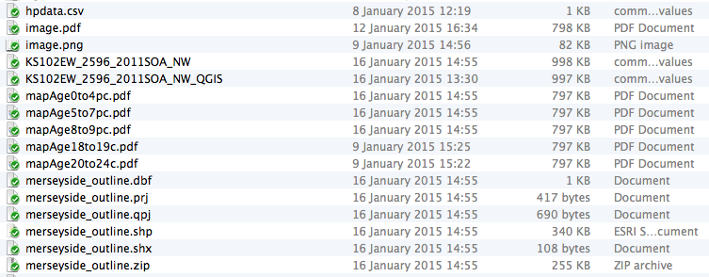
Saving Files
And script file…..

Slide 66
Code recap
Useful tips
Up arrow in the console shows you the previous command
History contains a history of all commands
Plot window has a back arrow, and an export option
Scripts

Slide 67
Survey Questions
Part of my research is GIS teaching
Very quick (7 ques) survey of your GIS experience
Follow up in 6 months / 1 year
Optional

Slide 68
Survey & Practical 2
bit.ly/17PsG7g
Then please carry on with Practical

Slide 69
Outline of the day
10:10am – 10:50am – What is GIS & R?
10:50am – 11:15am – P Intro to GIS
11:15am – 11:45am – Classification
11:45am – 12:30pm – P Classification
12:30pm – 1:15pm – Lunch
1:15pm – 2:30pm – P Making Maps
2:30pm – 2:45pm – Coffee
2:45pm – 3:30pm – P Analysis
3:30pm - 4pm – Mapping Discussion

Slide 70
Lunch

Slide 71
Outline of the day
10:10am – 10:50am – What is GIS & R?
10:50am – 11:15am – P Intro to GIS
11:15am – 11:45am – Classification
11:45am – 12:30pm – P Classification
12:30pm – 1:15pm – Lunch
1:15pm – 2:30pm – P Making Maps
2:30pm – 2:45pm – Coffee
2:45pm – 3:30pm – P Analysis
3:30pm - 4pm – Mapping Discussion

Slide 72
Code recap
Scripts
Highlight: click Run or Ctrl-Enter

Slide 73
Data Structure – Slot Names
Slot Names slotNames(LSOAs)
"data"
"polygons"
"bbox"
"proj4string"

Slide 74
Data Structure – Slot Names
Slot Names slotNames(LSOAs)
"data” ”polygons” "bbox" "proj4string”
LSOAs@data
LSOAs@data$LSOA_CODE
@ and $
Try running
LSOAs@proj4string

Slide 75
Code recap
Plotting Maps
plot(LSOAs,
col = my_colours[findInterval (var, breaks, all.inside = TRUE)],
axes = FALSE,
border = rgb(0.8,0.8,0.8))

Slide 76
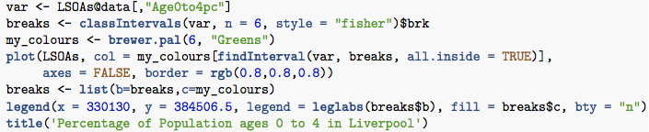
Making Maps from Census Data
Same as before

Slide 77
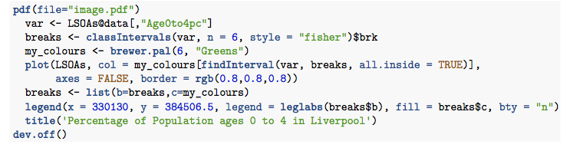
Making Maps from Census Data
Same as before, … but:
Save as PDF

Slide 78
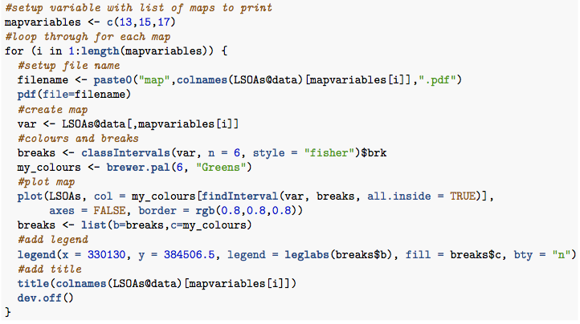
Making Maps from Census Data
Same as before, … but:
Save as PDF & Loop

Slide 79
Making Maps from Census Data

Slide 80
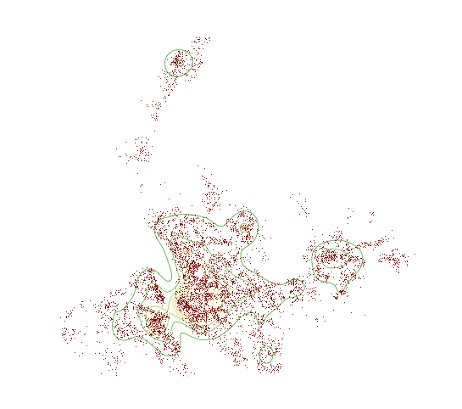
Clustering, ‘Heat-map’ style

Slide 81
Practical

Slide 82
Tea & Coffee

Slide 83
Outline of the day
10:10am – 10:50am – What is GIS & R?
10:50am – 11:15am – P Intro to GIS
11:15am – 11:45am – Classification
11:45am – 12:30pm – P Classification
12:30pm – 1:15pm – Lunch
1:15pm – 2:30pm – P Making Maps
2:30pm – 2:45pm – Coffee
2:45pm – 3:30pm – P Analysis
3:30pm - 4pm – Mapping Discussion

Slide 84

Mapping Discussion
Common Problems in Mapping
http://digiwonk.wonderhowto.com/how-to/lose-your-connection-add-for-chrome-and-firefox-helps-you-recover-missing-text-and-erased-forms-0142484/

Slide 85

Common Problems in Mapping
Data availability
Google, other work
Losing work
Saving, backups, testing backups
Specific feature not working
Restart and try again
Google, Stack Exchange (http://www.stackexchange.com/)
How do I do x in y?
Google, colleagues

Slide 86
Mapping Discussion
What problems have you encountered?
(How did you solve them?)
What are you currently working on?

Slide 87
Next Steps
Other GIS:
ArcGIS & QGIS
Courses on analysis:
An Introduction to Spatial Microsimulation Using R (Leeds)
Online resources

Slide 88
Feedback
Feedback is really important for me
Post-its
One thing you found fun
One thing you found challenging and useful
One thing you would improve
Or email / phone / in person

